Slide 1
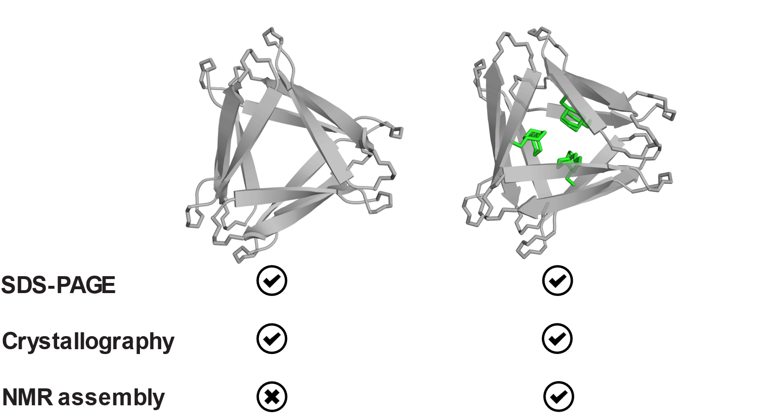

F19Cha assembles in solution-phase NMR while KLF does not
KLF
F19Cha
(hexamer)
(hexamer)
KLF: Xaa = Phe
F19Cha: Xaa = Cyclohexylalanine
(hexamer)
(hexamer)
(dodecamer?)
Kreutzer, A. G.; Nowick, J. S. Biochemistry 2017, 56, 6061-6071.

Slide 2
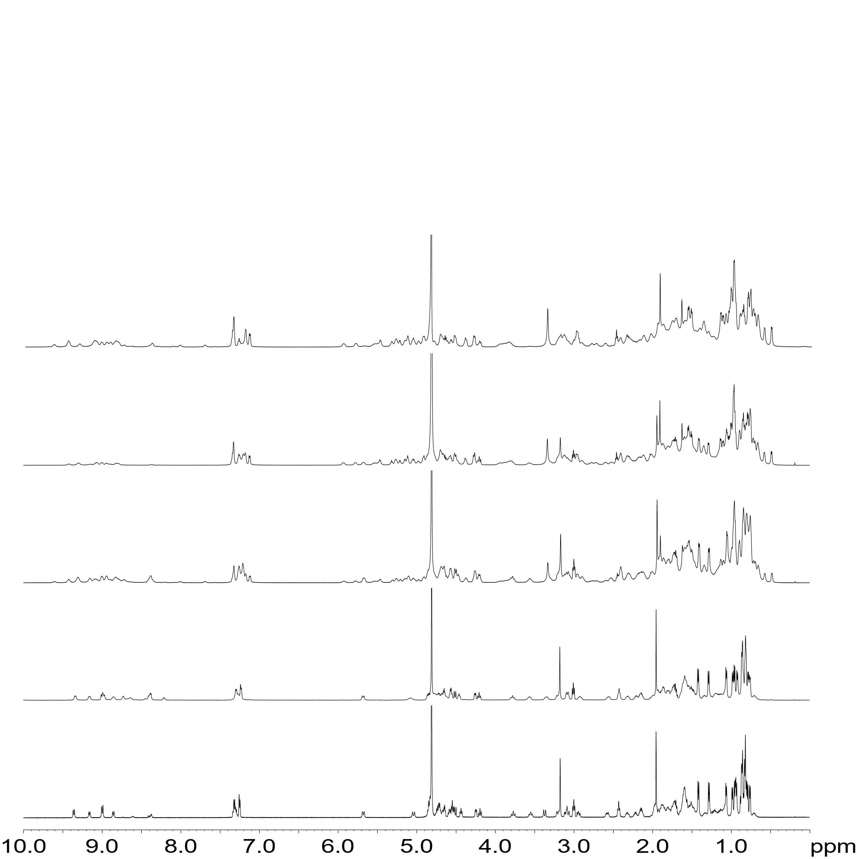



F19Cha shows concentration dependent assembly in D₂O
T = 298 K
Downfield shifted H$α$ peaks
Upfield shifted Leucine
CH₃’s
Met35 $ε$-CH₃
monomer
oligomer
New Phe₂₀ peaks
N-Me
monomer
oligomer
(coincident)
11 mM F19Cha
N-Me H$α$
monomer
oligomer
6 mM F19Cha
4 mM F19Cha
Oligomerization begins here
2 mM F19Cha
1 mM F19Cha
Note: 11 mM F19Cha spectrum contains 0.06 mM DSA as an internal standard

Slide 3
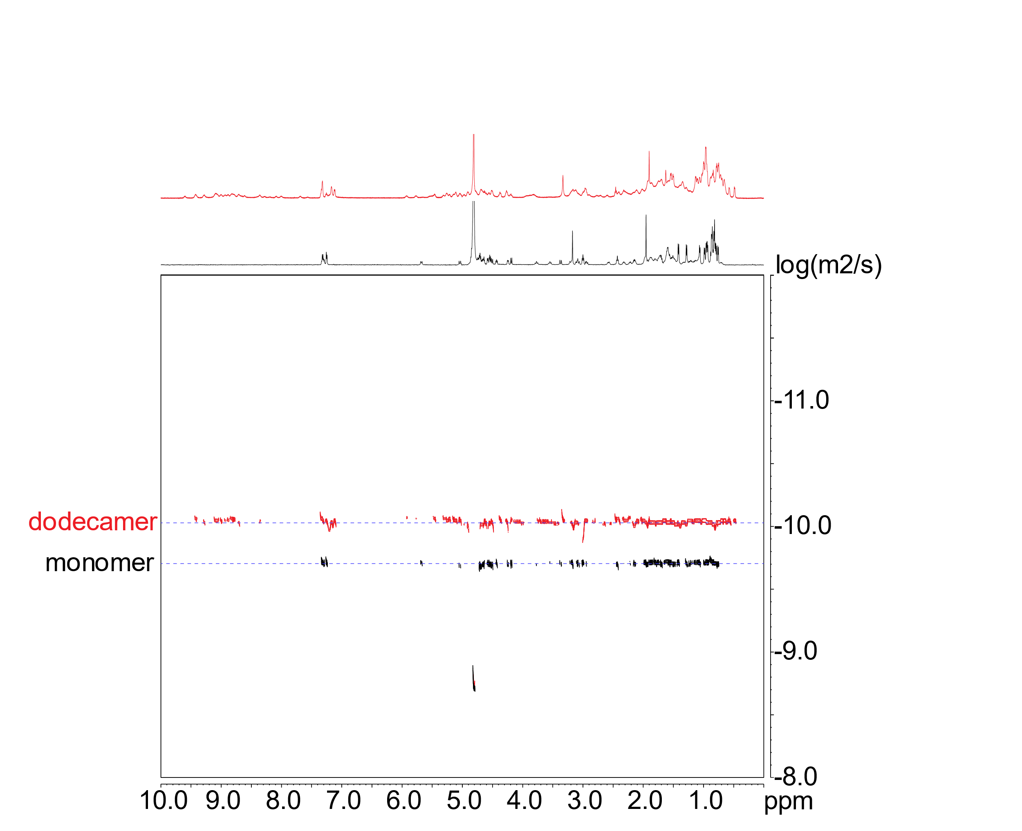


F19Cha oligomerizes into a putative dodecamer
DOSY in D₂O at 298 K
11 mM F19Cha
1 mM F19Cha
$$D \text{∝}{ M}^{\frac{−1}{3}}$$
Species | Diffusion Coefficient Quotient
Dimer | 0.79
Trimer | 0.69
Tetramer | 0.63
Hexamer | 0.55
Dodecamer | 0.44
10^{-10.034} = 0.925 * 10⁻¹⁰ m²/s
Key Assumption: hard spheres
10^{-9.697} = 2.01 * 10⁻¹⁰ m²/s
$$\frac{0.925}{2.01}=0.46$$
Longsworth, L. G. J. Phys. Chem. 1960, 64, 1914–1917.

Slide 4
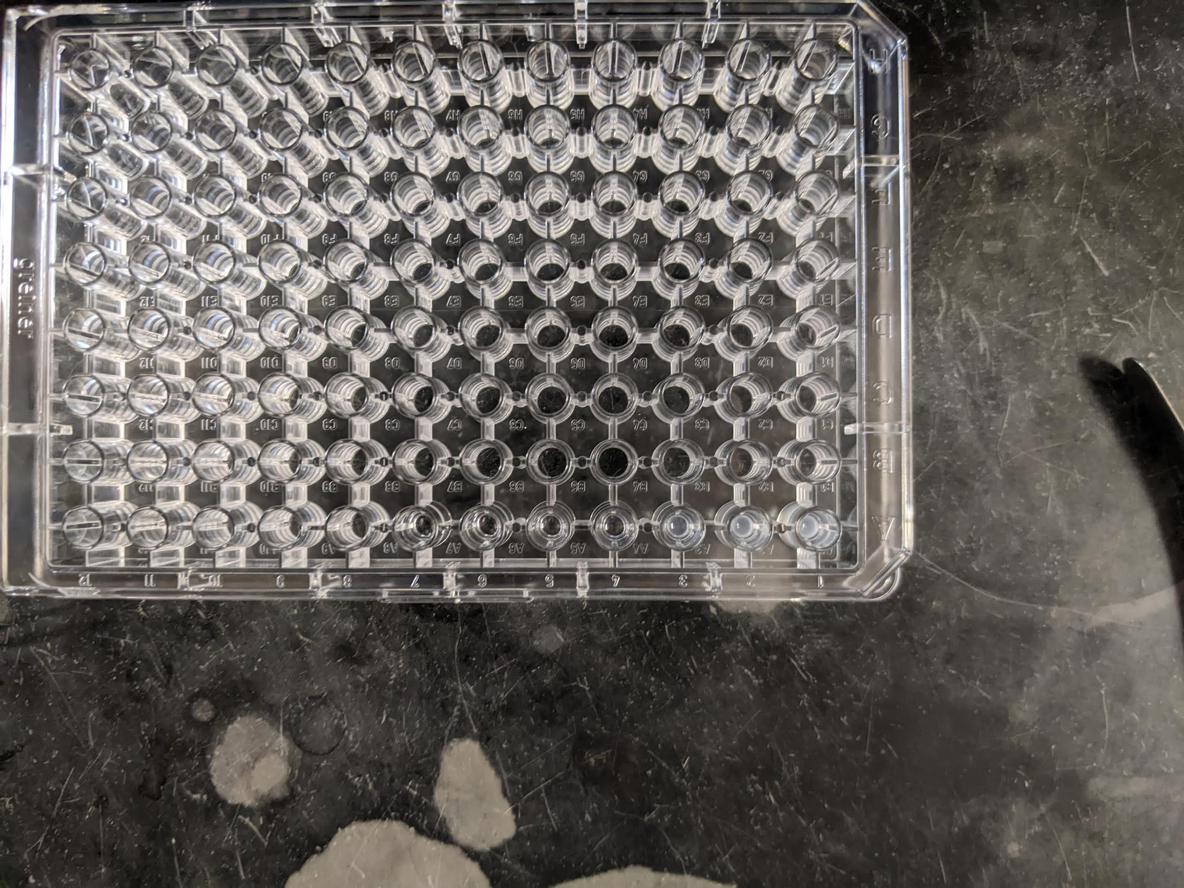
Attempts to add counterions cause F19Cha to salt out
Workflow overview
1. Make a concentrated 2x solution of peptide and salt
2. Mix 1:1 in 96-well plate
3. Read OD₆₀₀
Representative photo of what I see in the plates
100 mM NaCl
0 mM NaCl
Concentration windows where salting out occurs appreciably
Working F19Cha concentration 1 mM

Slide 5
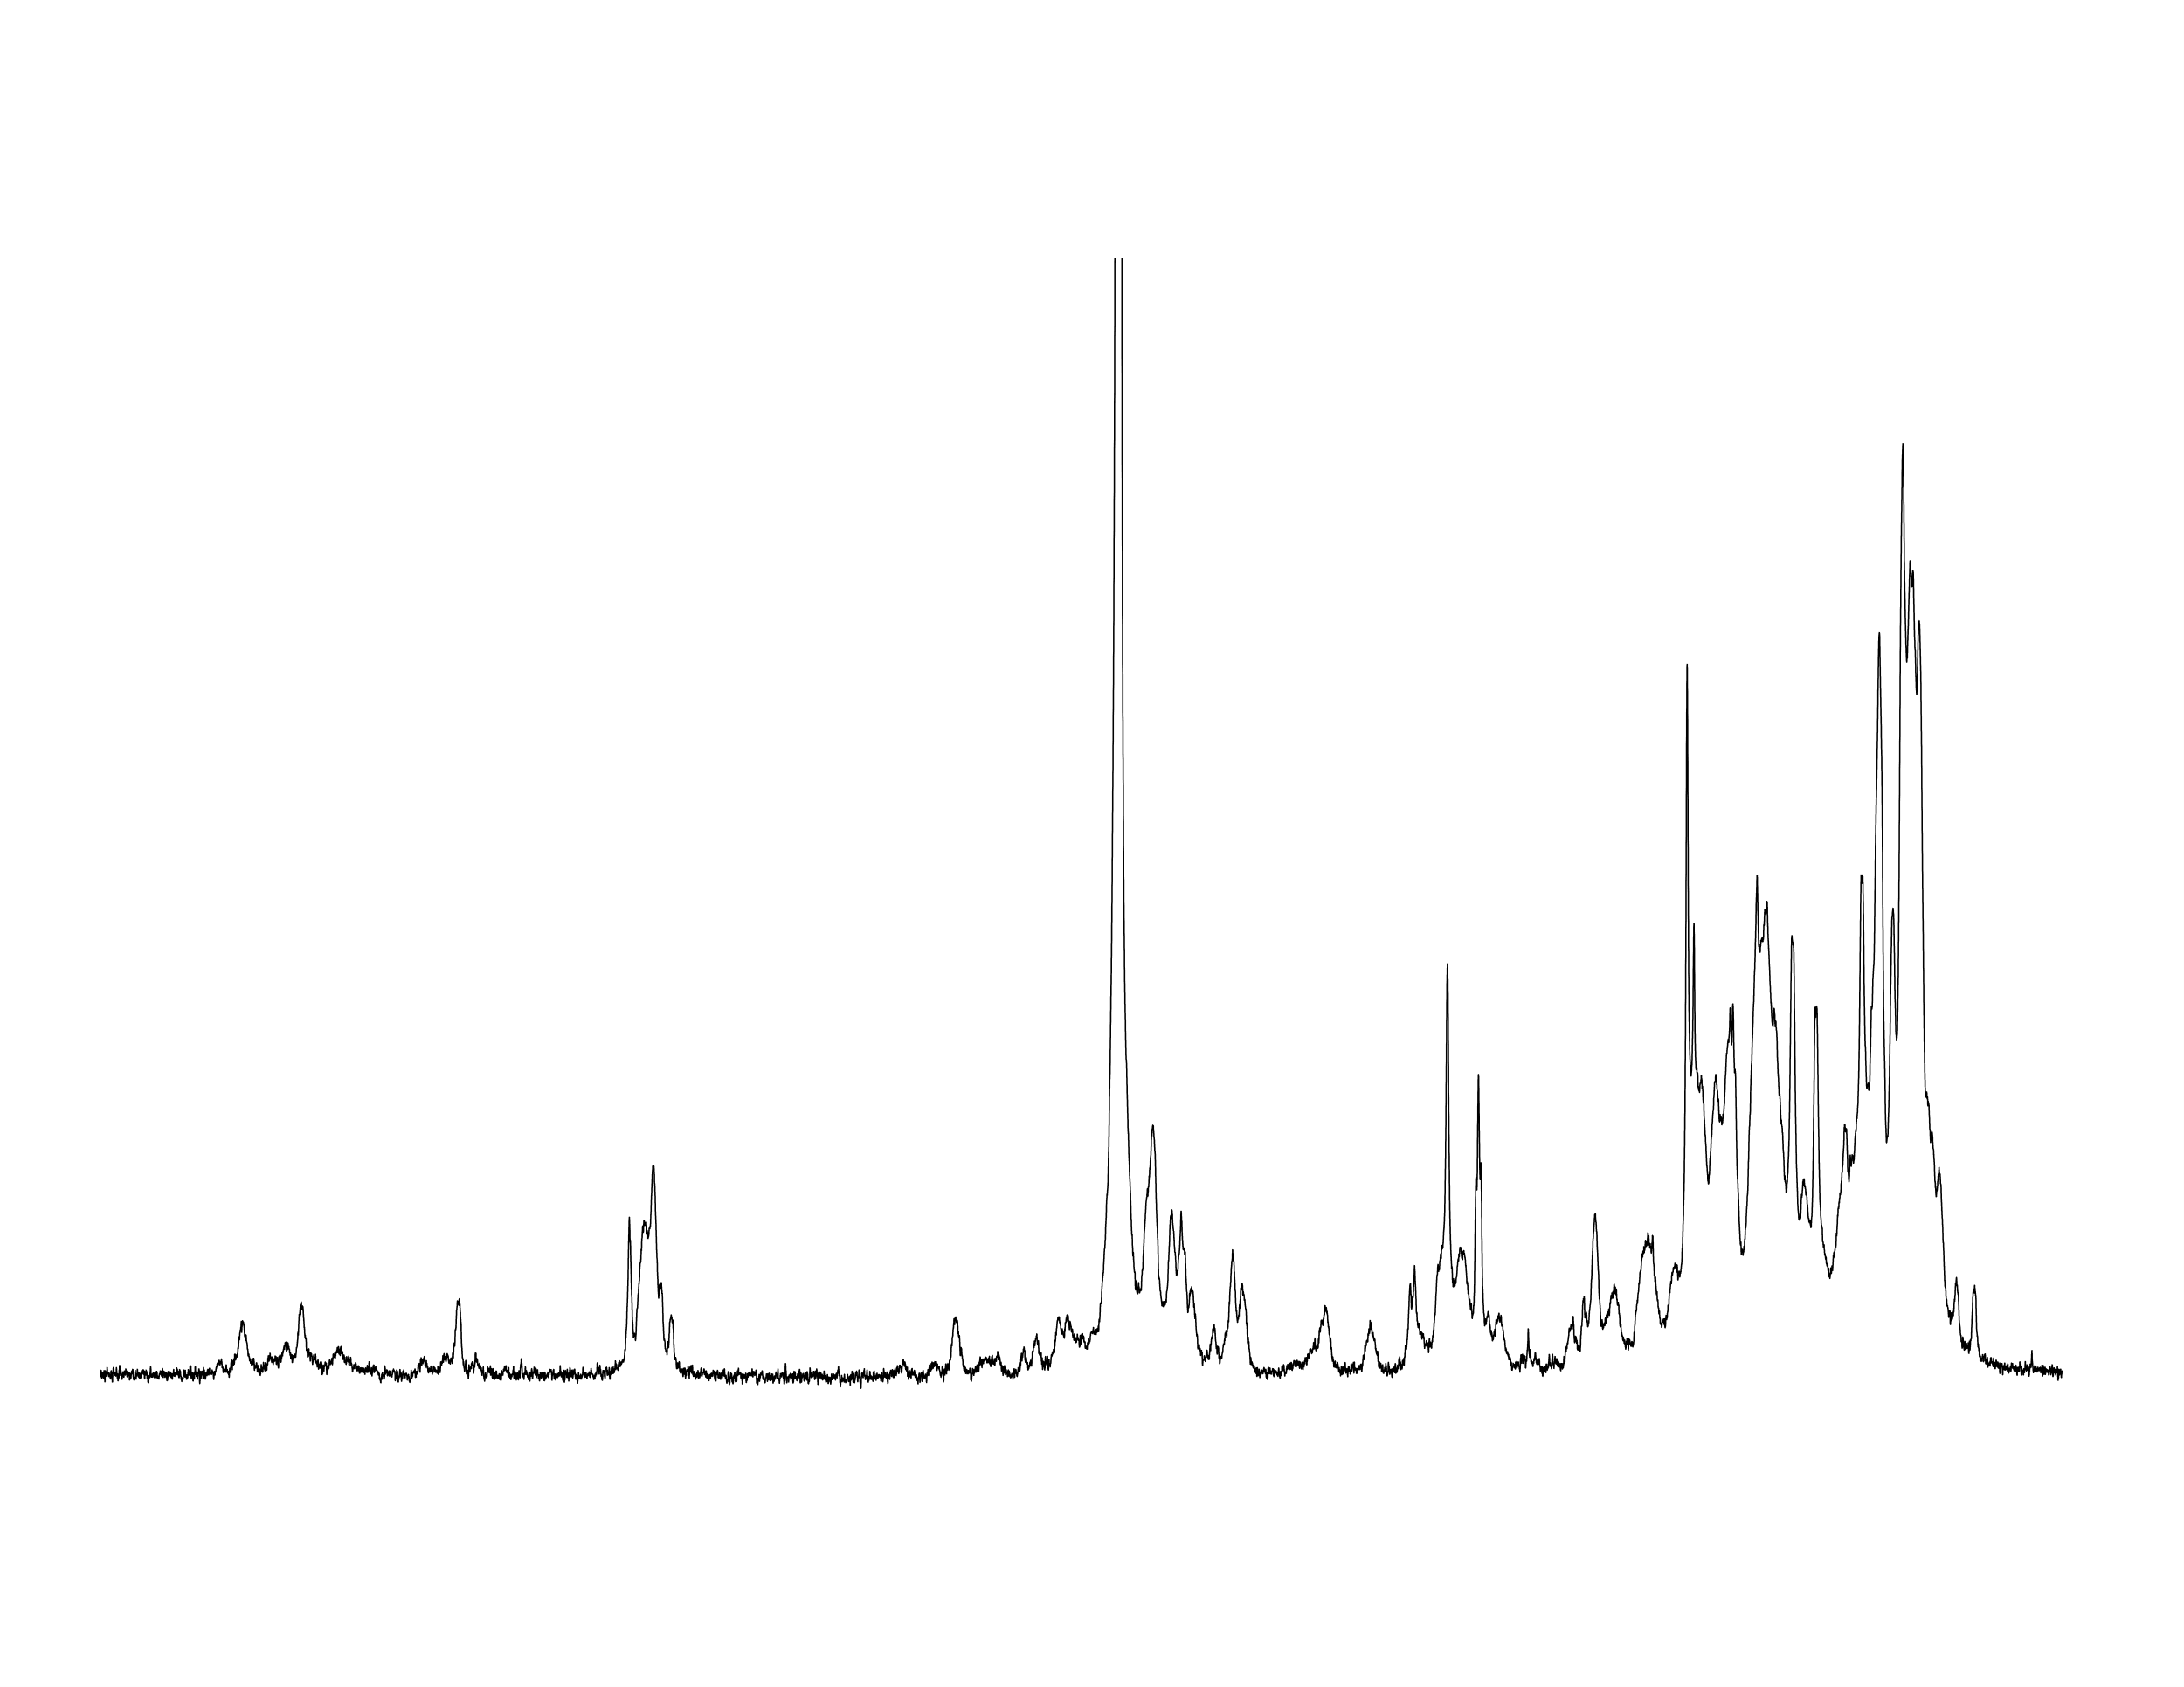
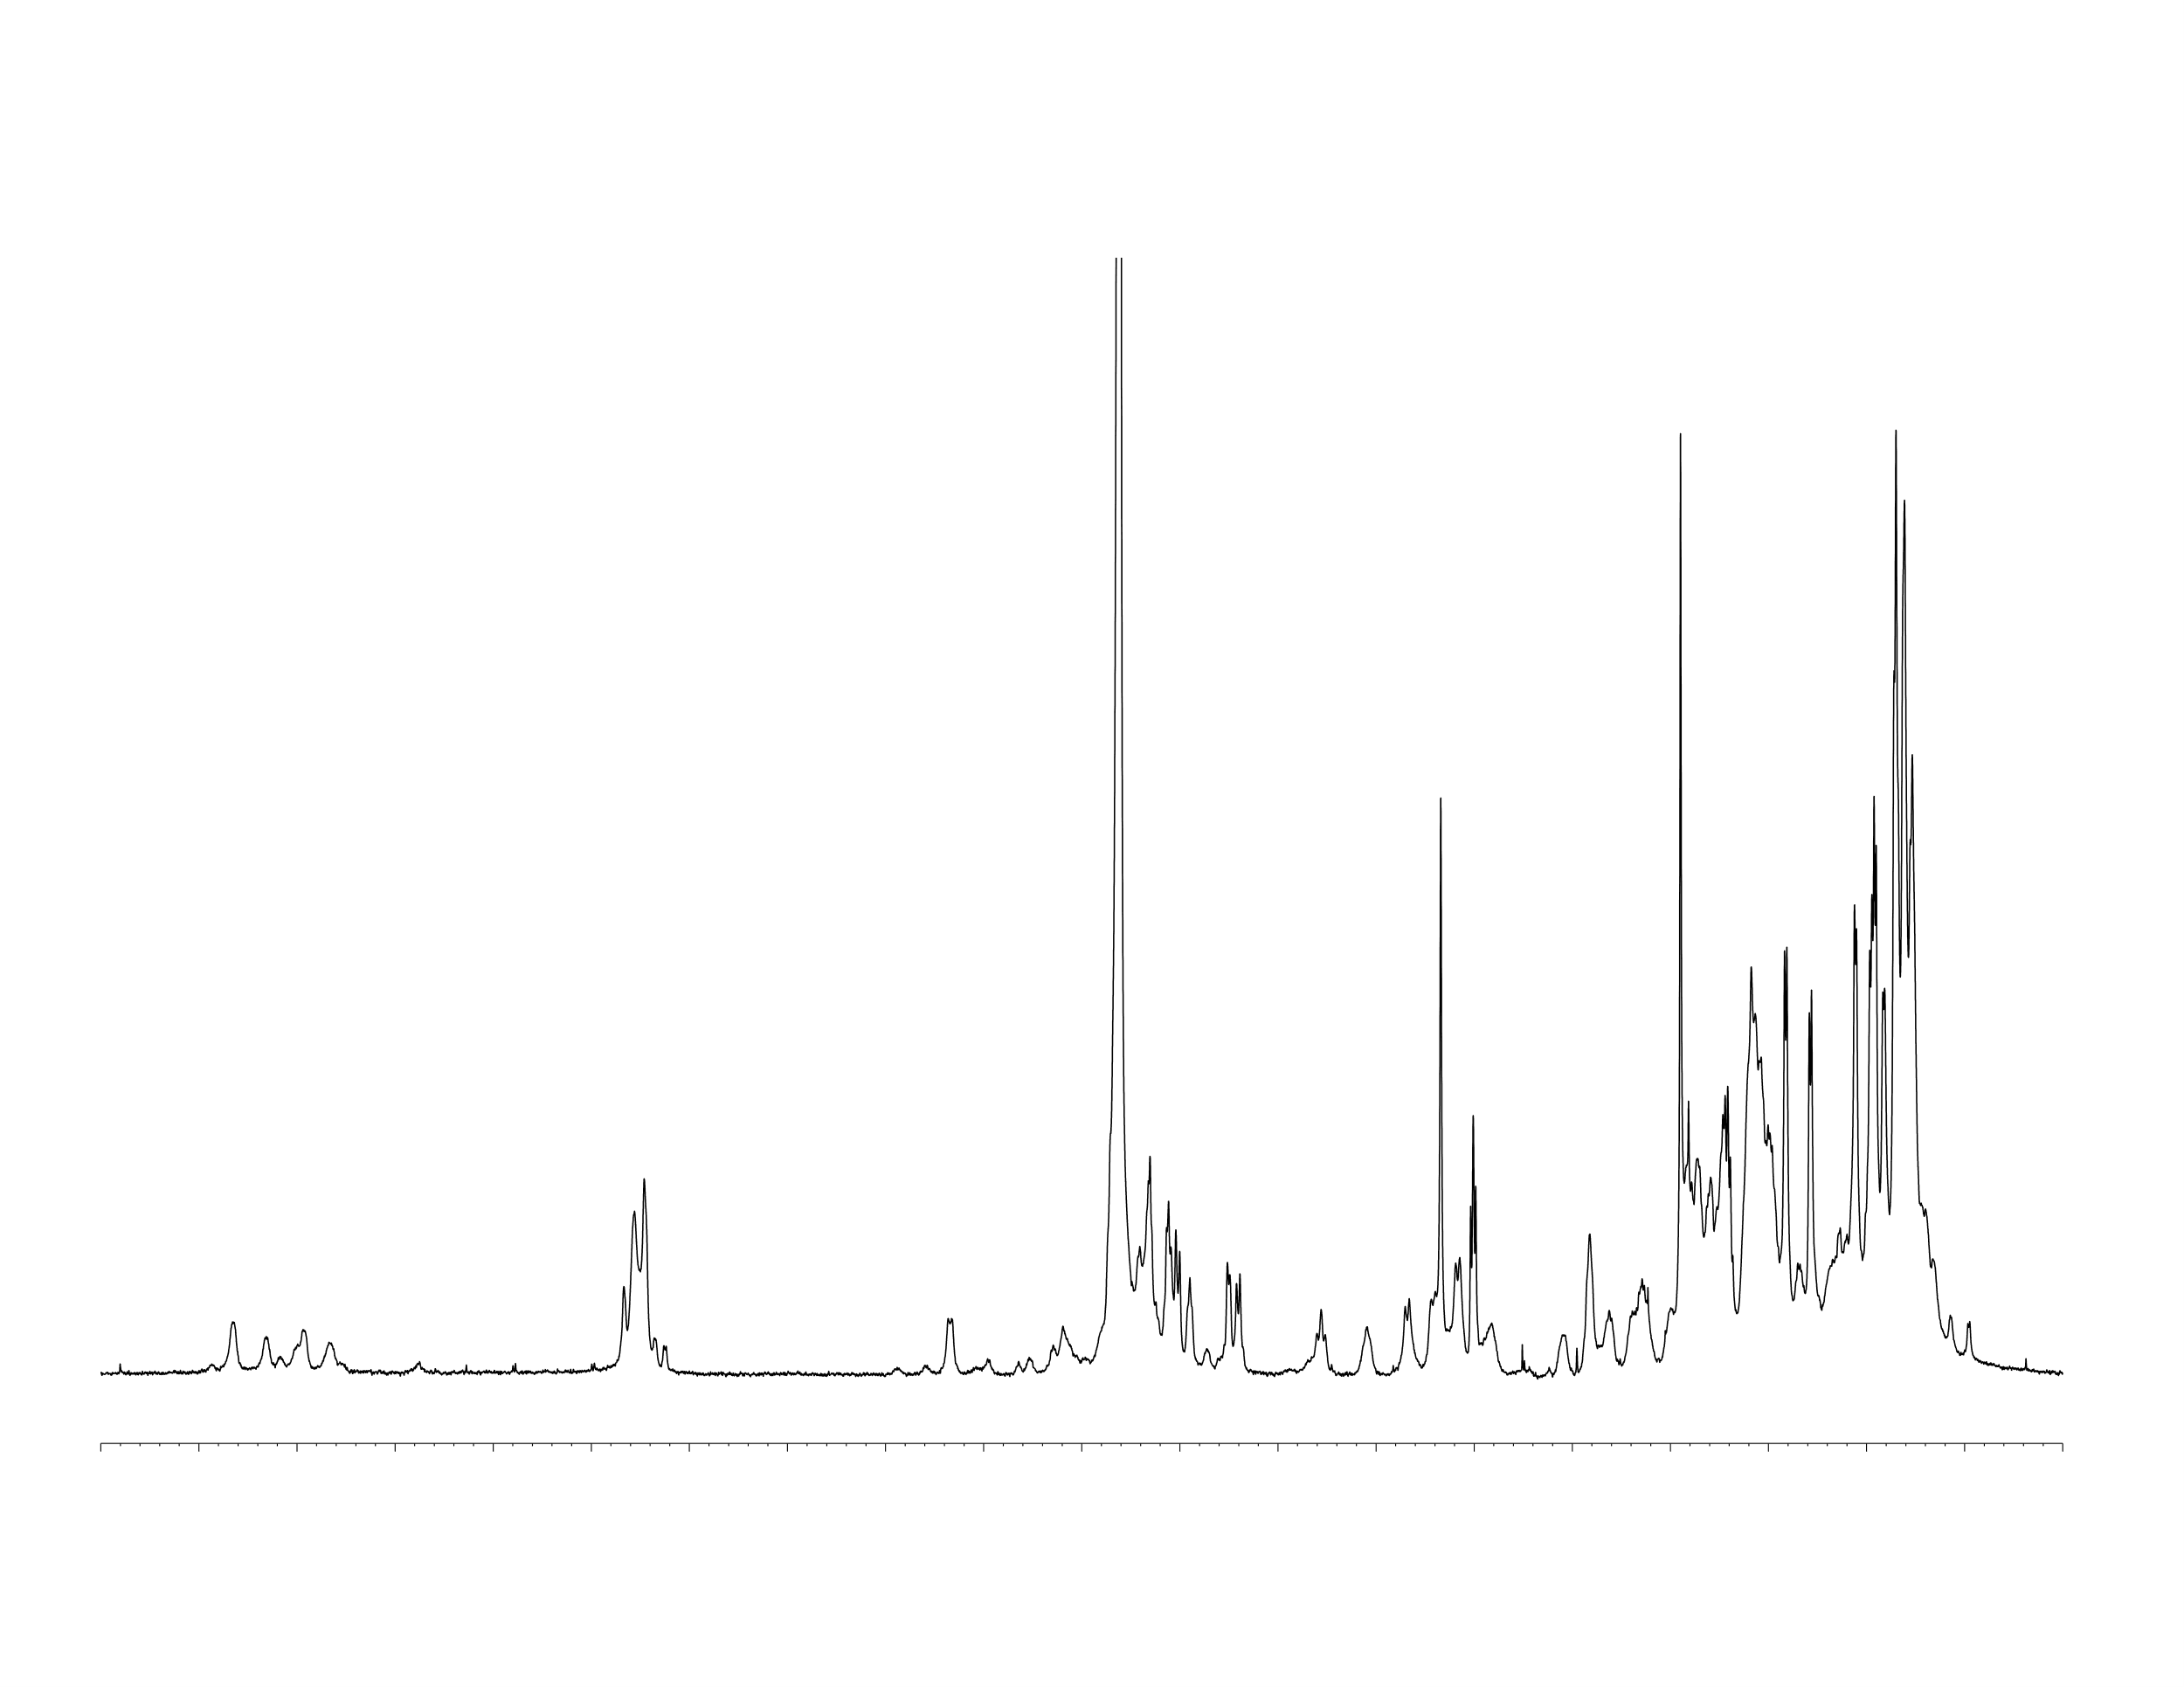
F19Cha oligomerizes at lower concentrations with additives
Peaks consistent with oligomerization
1 mM F19Cha + 50 mM DCl
64 scans, lb = 1 Hz
1 mM F19Cha + 25 mM NaCl
64 scans, lb = 1 Hz
10.0
9.0
8.0
7.0
6.0
5.0
4.0
3.0
2.0
1.0
ppm
Note: S/N appreciably decreases which likely means larger NMR-invisible aggregates.

Slide 6
Proposed AUC Experimental Conditions
Sedimentation velocity (SV) and Sedimentation equilibrium (SE)
1, 4, 8 mM (no additives)
100, 500, 1 µM + 25 mM NaCl
I would prefer to run with no additives so data can directly be compared with my NMR studies but I can add in NaCl at low peptide concentrations to prevent non-ideal effects.

Slide 7
Q’s for Borries / Discussion Points
1. Running F19Cha with no salt. And dealing with non-ideal effects post-run? How much excess salt do you want relative to peptide if we need to add in to avoid non-ideal effects?
2. How many rotor slots? Rotor speeds? Salt/Peptide Concentrations (I can easily adjust the conditions) Multiple wavelengths?
3. If the peptide is partially salted out, how easy is it for you to separate out larger aggregates if there is still some monomer/oligomer?

Slide 8
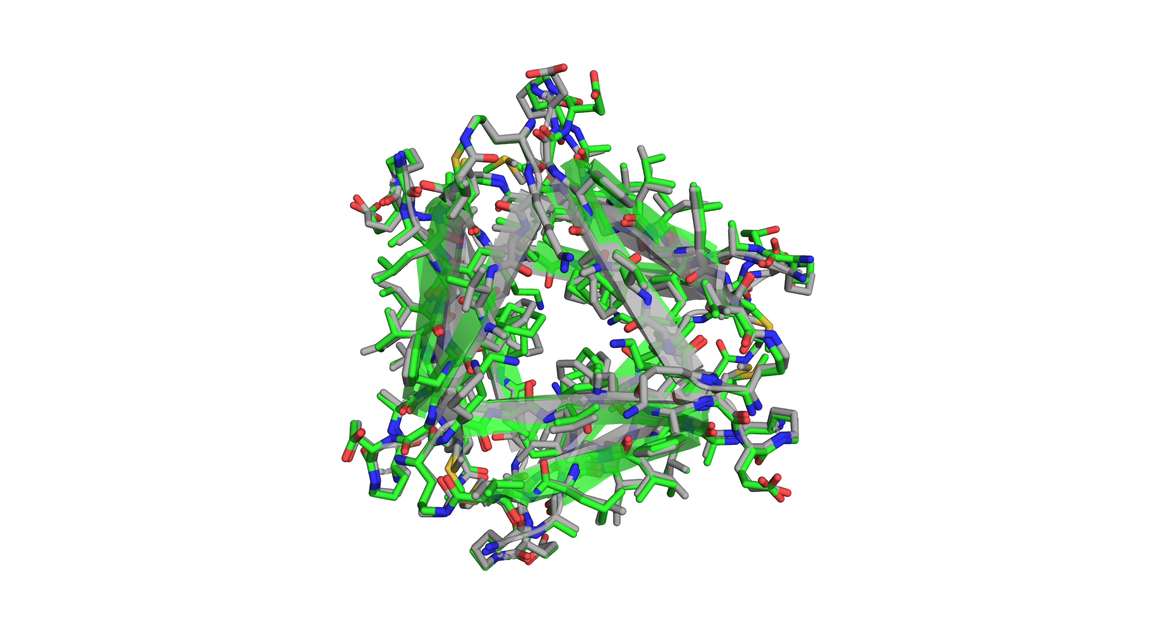
S1. F19Cha crystallizes into hexamers analogous to KLF
Green = F19Cha
Grey = KLF
Resolution: 1.58 Å
R_{free} = 0.22
R_{work} = 0.21
With Dr. Adam Kreutzer
Kreutzer, A. G.; Nowick, J. S. Biochemistry 2017, 56, 6061-6071.

Slide 9
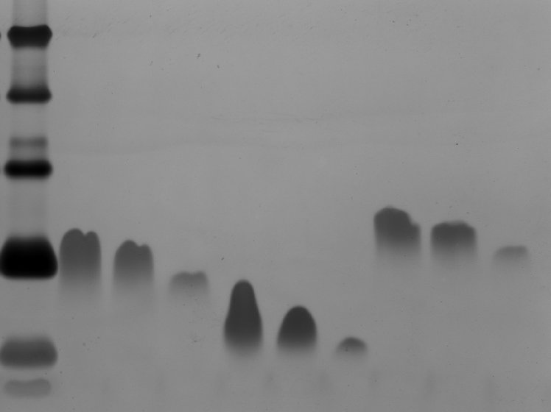
S2. F19Cha assembles into hexamers in silver stained SDS-PAGE
kDa
ladder
KLF
V18T F20Y
F19Cha
40
25
15
10
hexamer (10.6 kDa)
4.6
trimer (5.3 kDa)
1.7
0.5
0.3
0.1
0.5
0.3
0.1
0.5
0.3
0.1
mg/mL peptide
Ignore V18T F20Y. It is another mutant that I tried getting to assemble by NMR that I have since discontinued studying.

Slide 10
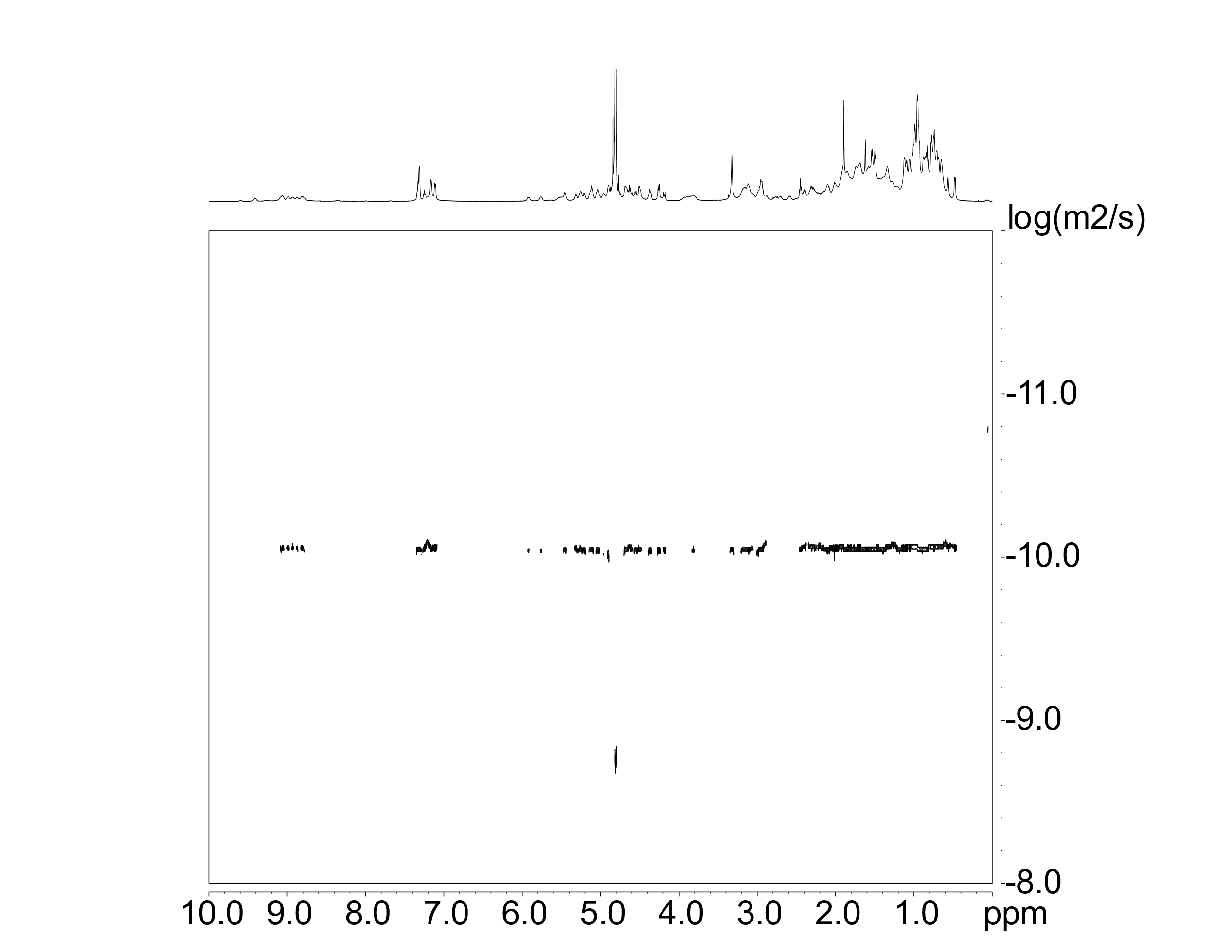
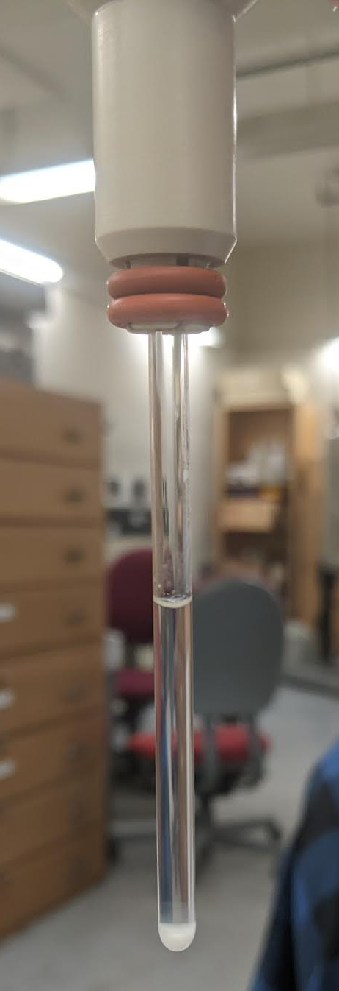

S3. Nominal 16 mM F19Cha in D₂O
DOSY in D₂O at 298 K
Species | Diffusion Coefficient Quotient
Dimer | 0.79
Trimer | 0.69
Tetramer | 0.63
Hexamer | 0.55
Dodecamer | 0.44
10^{-10.047} = 0.897 * 10⁻¹⁰ m²/s
Monomer: 10^{-9.697} = 2.01 * 10⁻¹⁰ m²/s
Solubility limit of F19Cha is ca. 11-12 mM in water.
$$\frac{0.897}{2.01}=0.45$$
Not fully soluble at 16 mM
HOD peak calibrated to 1.90 * 10⁻⁹ m²/s
Longsworth, L. G. J. Phys. Chem. 1960, 64, 1914–1917.

Slide 11
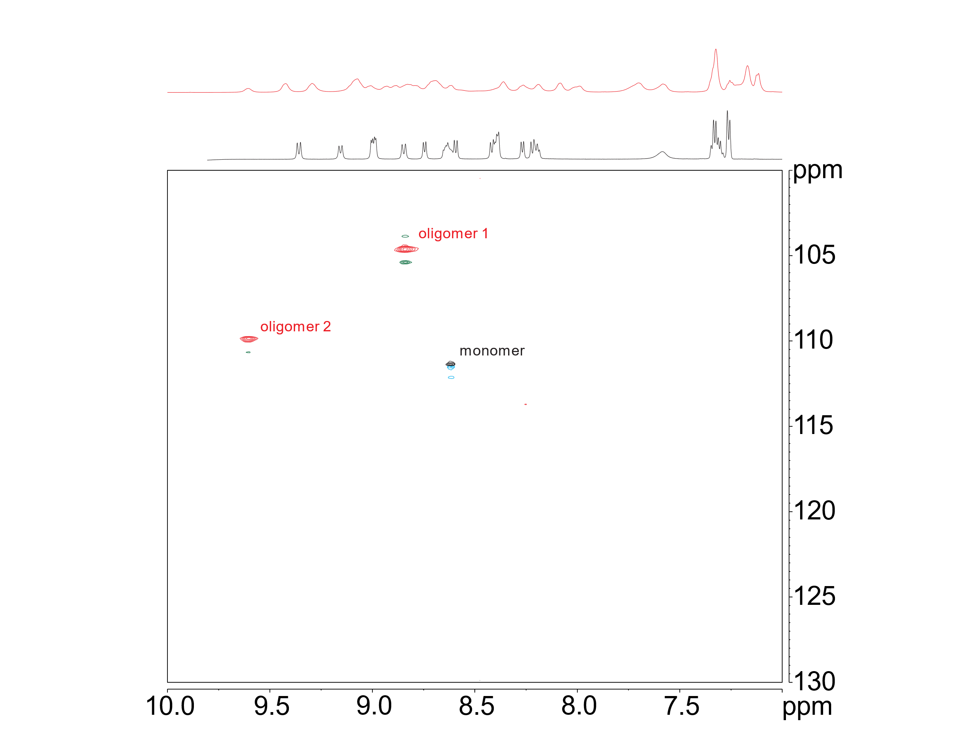
S4. ¹⁵N-HSQC reveals the formation of two oligomers
T = 298 K
11 mM F19Cha (unlabeled)
1 mM F19Cha (unlabeled)
Labeled at ¹⁵N Gly₃₃
Why label at Gly₃₃?
¹⁵N labeled Gly is relatively cheap
Potential Intermolecular NOEs from ¹⁵N-NOESY
Notes:
To answer how many species, I decided to run 15N-edited HSQC
Synthesized isotopologue where I strategically labeled Gly33
1 mM – 1 peak
11 mM – 2 peaks indicating I have 2 oligomers
3rd species integrates to 1.2%. (maybe impurity or noise, idk)
HSQC = heteronuclear single quantum coherence (HSQC)
Magnetization transfer from proton to second nucleus via INEPT (insensitive nuclei enhanced by polarization transfer)
Then transfer back to proton dimension
1 peak = 1 species

